Slide 1
Use Case – ATM Example
Actors:
  ATM Customer
  ATM Operator
Use Cases:
  The customer can
    withdraw funds from a checking or savings account
    query the balance of the account
    transfer funds from one account to another
  The ATM operator can
    Shut down the ATM
    Replenish the ATM cash dispenser
    Start the ATM

Slide 2
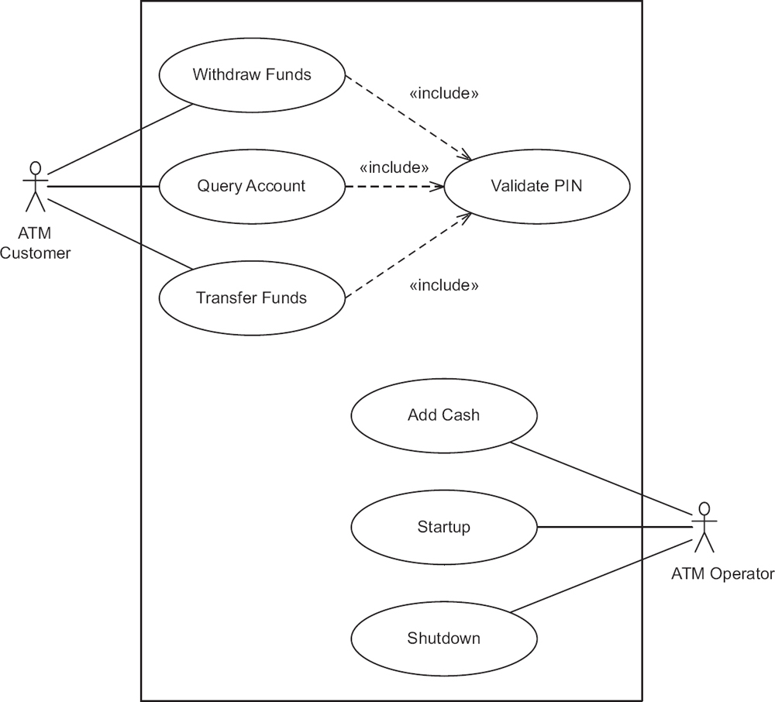
Use Case – ATM Example
Notes:
It can be seen that the first part of each use case - namely, reading the ATM card and validating the customer's PIN - is common to all three use cases. This common part of the three use cases is factored out as an inclusion use case called Validate PIN.

Slide 3
Use Case – ATM Example
Validate PIN is an Inclusion Use Case
  It cannot be executed on its own
  Must be executed as part of a Concrete Use Case
On the other hand, a Concrete Use Case can be executed
Notes:
Inclusion use cases always reflect functionality that is common to more than one use case. When this common functionality is separated into an inclusion use case, the inclusion use case can be reused by several base (executable) use cases. Inclusion use cases can often be developed only after an initial iteration in which several use cases have been developed. Only then can repeated sequences of interactions be observed that form the basis for the inclusion use cases.

Slide 4
Use Case – Validate PIN (1)
Use case name: Validate PIN
Summary: System validates customer PIN
Actor: ATM Customer
Precondition: ATM is idle, displaying a Welcome message.

Slide 5
Use Case – Validate PIN (2)
Main sequence:
  Customer inserts the ATM card into the card reader.
  If system recognizes the card, it reads the card number.
  System prompts customer for PIN.
  Customer enters PIN.
  System checks the card's expiration date and whether the card has been reported as lost or stolen.
  If card is valid, system then checks whether the user-entered PIN matches the card PIN maintained by the system.
  If PIN numbers match, system checks what accounts are accessible with the ATM card.
  System displays customer accounts and prompts customer for transaction type: withdrawal, query, or transfer.

Slide 6
Use Case – Validate PIN (3)
Alternative sequences:
Step 2: If the system does not recognize the card, the system ejects the card.
Step 5: If the system determines that the card date has expired, the system confiscates the card.
Step 5: If the system determines that the card has been reported lost or stolen, the system confiscates the card.
Step 7: If the customer-entered PIN does not match the PIN number for this card, the system re-prompts for the PIN.
Step 7: If the customer enters the incorrect PIN three times, the system confiscates the card.
Steps 4-8: If the customer enters Cancel, the system cancels the transaction and ejects the card.
Postcondition: Customer PIN has been validated.

Slide 7
Use Case – Withdraw Funds (1)
Use case name: Withdraw Funds
Summary: Customer withdraws a specific amount of funds from a valid bank account.
Actor: ATM Customer
Dependency: Include Validate PIN use case.
Precondition: ATM is idle, displaying a Welcome message.

Slide 8
Use Case – Withdraw Funds (2)
Main sequence:
  Include Validate PIN use case.
  Customer selects Withdrawal, enters the amount, and selects the account number.
  System checks whether customer has enough funds in the account and whether the daily limit will not be exceeded.
  If all checks are successful, system authorizes dispensing of cash.
  System dispenses the cash amount.
  System prints a receipt showing transaction number, transaction type, amount withdrawn, and account balance.
  System ejects card.
  System displays Welcome message.

Slide 9
Use Case – Withdraw Funds (3)
Alternative sequences:
Step 3: If the system determines that the account number is invalid, then it displays an error message and ejects the card.
Step 3: If the system determines that there are insufficient funds in the customer's account, then it displays an apology and ejects the card.
Step 3: If the system determines that the maximum allowable daily withdrawal amount has been exceeded, it displays an apology and ejects the card.
Step 5: If the ATM is out of funds, the system displays an apology, ejects the card, and shuts down the ATM.
Postcondition: Customer funds have been withdrawn (only for the main sequence).

